Slide 1

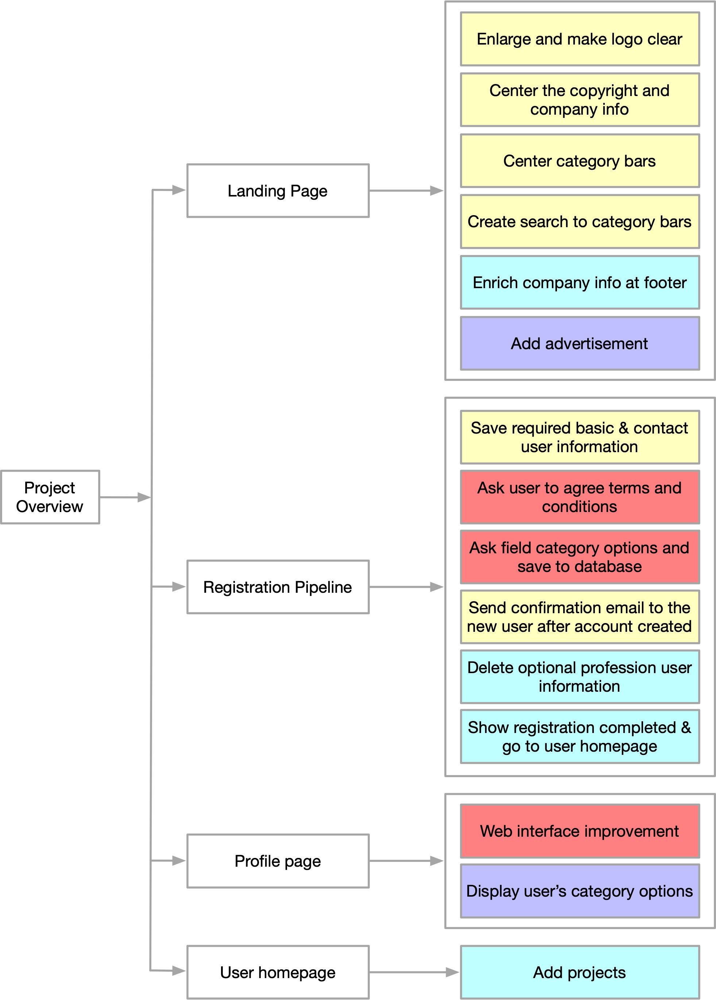
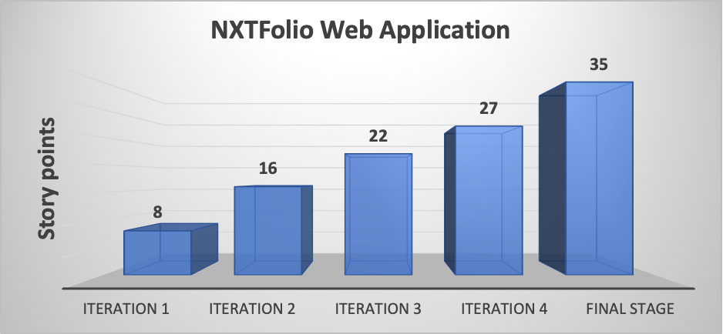
NXTFolio Web Application
RWBY Team (Fall 2021): Chuqi Zhang, Cong Fu, Haiyang Yu, Kehan Meng, Shuirui Gui, Zhao Xu, Zihan Wang Department of Computer Science and Engineering, Texas A&M University
Dept. of Computer Science and Engineering, Texas A&M University
,
Introduction
Design
The goal of the project is to allow people in fashion industry to show their creative work and network with professionals they have interest
The web-based application allows users to search for the matching profiles in fashion domain
The application allows users to upload project and rate on other’s projects
Our new features cover a wide range of the application components, including the landing page, registration pipeline, profile page, and user home page
User Stories
User Story 1: Fix a bug in the registration pipeline so that the new user can register an account successfully
User Story 2: Send confirmation and welcome email to newly registered users from fashionnxt2021@gmail.com
User Story 3: Improve the landing page user interface by enlarge logo, centering the category bars and information in footer
User Story 4: Ask user to agree terms and conditions before the final step of registration
User Story 5: Collect field category details by asking new users to check options during registration, and save to database
User Story 6: Improve the profile page user interface by modifying the background and project display
User Story 7: Improve the footer of the landing page by adding detailed information and linking to corresponding page
User Story 8: Add project by clicking a plus sign placeholder located before all existing projects at the user homepage
User Story 9: Add a complete registration message after registration is done, and direct the new user to the homepage
User Story 10: Add an advertisement on the landing page
User Story 11: Display categorical options on user profiles
Iterations
ITERATION 0
GENERAL PICTURE &
CUSTOMER NEEDS
ITERATION 1
USER STORIES 1-3
ITERATION 2
USER STORIES 4-6
FINAL STAGE
REPORTS & POSTER & DEMO
ITERATION 4
USER STORIES 10-11
ITERATION 3
USER STORIES 7-9
Velocity Chart
Challenges & Future works
For the User story 6 that is about improving the user interface design of the profile page, in addition to what we have implemented, the customer also desires to enlarge the size of the project and shrink the gap among projects. However, we find it is a big challenge for us to achieve this need, because all images are stored in the AWS bucket, and it requires more complicated operations than we can handle. Next team is encouraged to work on this unsolved need.
In User story 5, we implement the feature to collect categorical options from every registered user. Based on this feature, the customer desires to implement a filter feature on the landing page. As categorical options are shown in the landing page, the customer expect that clicking a specific categorical option can filter out mismatched user profiles, and only display matched users on the landing page. Due to the time limitation, we have not started working on this feature. As the customer emphasizes this is a high-priority feature in the last meeting, we encourage the next team to work on this feature.
Conclusions
This application NXTFolio is desired by a fashion industry company FashioNXT to function like LinkedIn and indeed for people who involved in the fashion industry to network with each other. This application is built using Ruby on Rails framework, html, css and JavaScript, and is deployed via Heroku. Based on the legacy code, we update the working environment and implement 11 new user stories required by the customer. This application is not fully matured yet and is waiting for next passionate development team to continue working on it!
Acknowledgement
We would like to thank Prof Dr. Duncan Walker, our TA Gayathri Krishna, our grader Akshit Kharbanda and our client Mr.Tito Choudhary for providing us with clear requirements and clearing our doubts when ever needed. Their extensive support made it possible for us to complete the project.

